Slide 1
Virtual Reality
Y S Ramya Akarsha Sehwag
2015117 2015010

Slide 2
In Store
Introduction to VR
Motivation
Progressions in the field till Date
Technology empowering VR
Applications
Challenges and Future Work
Conclusion

Slide 3
What is Virtual Reality?

Slide 4


Slide 5
Types of Virtual Reality
Non Immersive
Semi Immersive
Fully Immersive

Slide 6
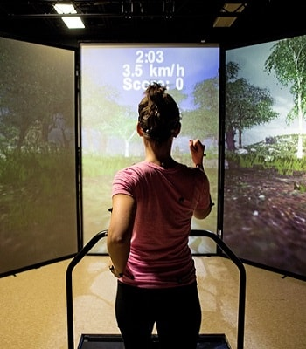
Non Immersive VR

Slide 7
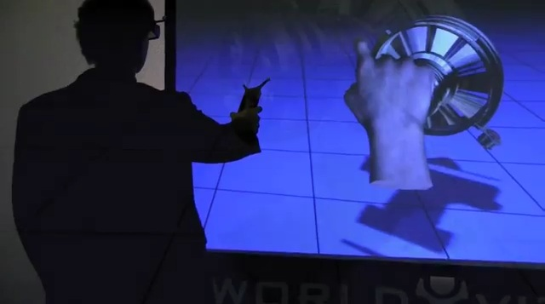
Semi Immersive VR

Slide 8
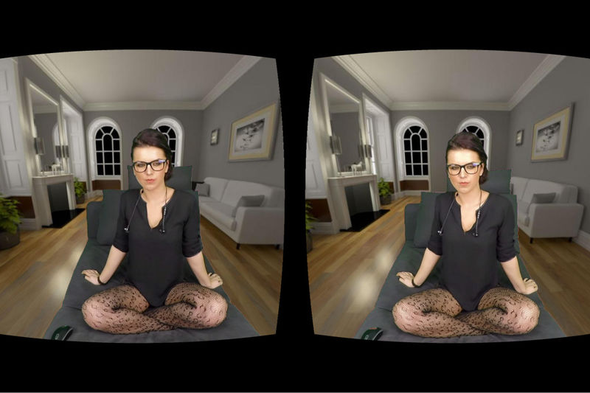
Immersive VR
Virtual Girlfriend
Notes:
Immersive VR

Slide 9
Motivation
It’s cool
Creative
The future of Human Computer Interaction

Slide 10
Where is VR?
In our hearts
The field has been active since the 1950s

Slide 11
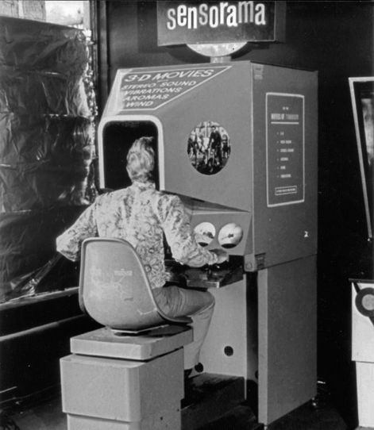
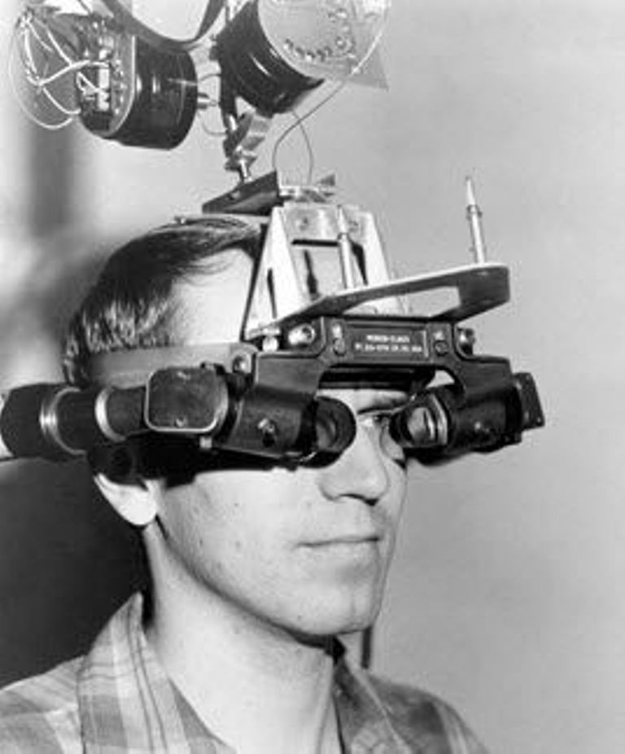
Sensorama
Sword of Damocles VR

Slide 12
GROPE
VIVED
VPL

Slide 13
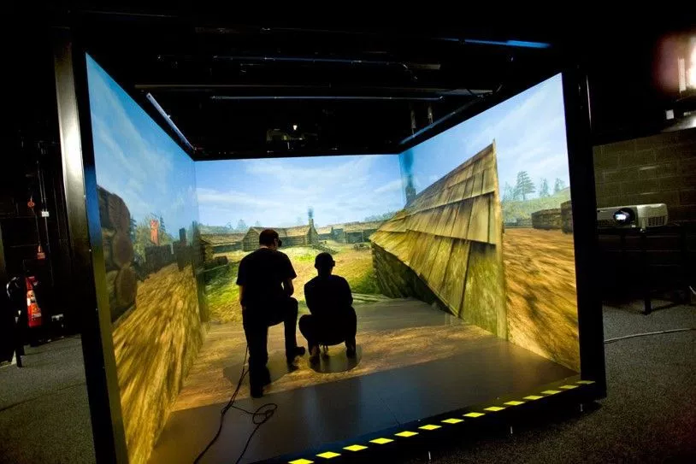
CAVE Automatic Virtual Environment

Slide 14
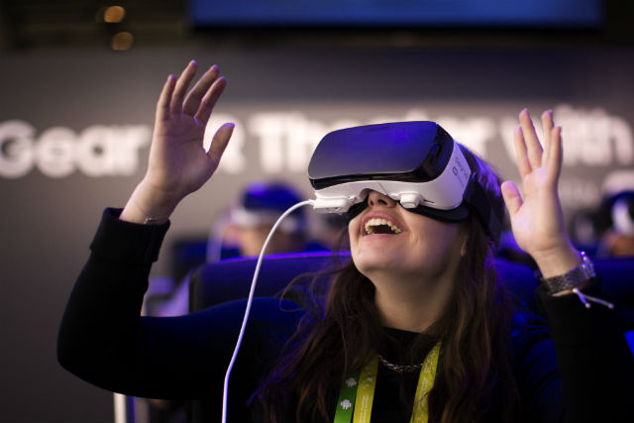
OCCULUS RIFT

Slide 15
Tech Behind Virtual Reality
Tracking in Virtual Environments
Visual Rendering
Audio Rendering

Slide 16
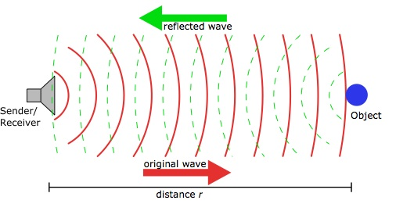
Tracking in VR
Acoustic Electromagnetic

Slide 17

Photo-realistic Visual Rendering
Path Tracing

Slide 18
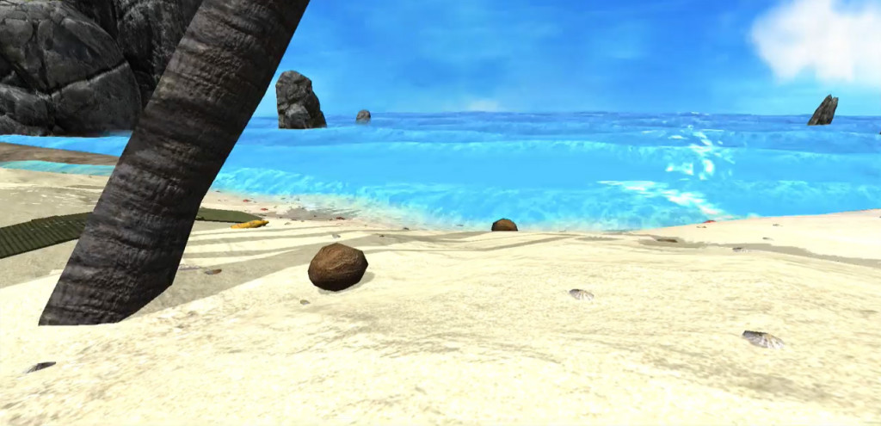

Slide 19
Audio Rendering
Sound Generation
Modelling room acoustics
Modelling Spatial Hearing
Interactive Audio rendering
Auralizing

Slide 20
Applications of VR
Medicine
Education and Training

Slide 21
Entertainment
Social Science and Psychology
Art, Architecture, and Design

Slide 22
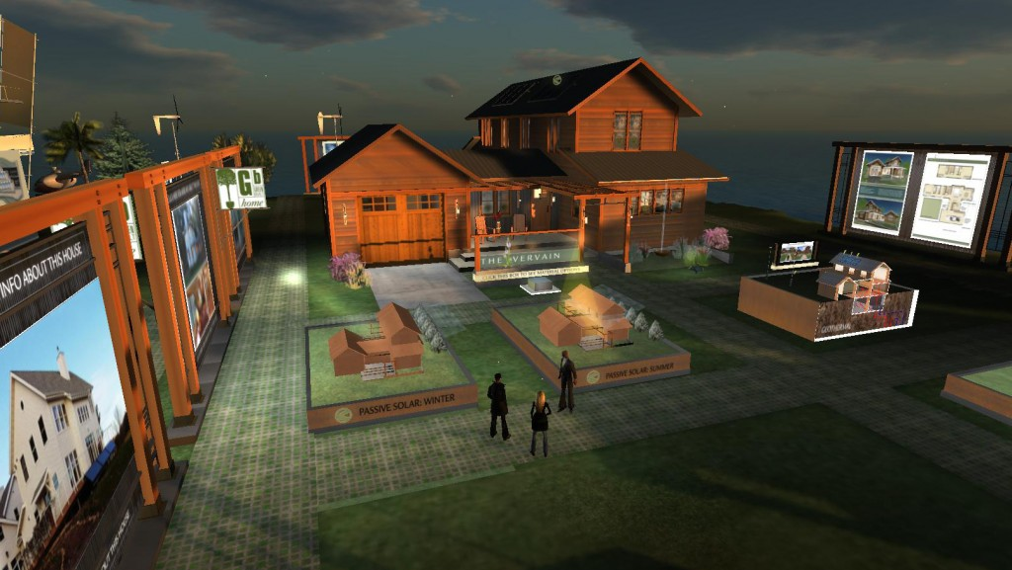

Slide 23
Challenges and Future Work
Computationally efficient methods
Research on Realistic rendering
Cost
Security
Health Effects

Slide 24

Thank You

